Slide 3
2023届新高三开学联考
英语试题

Slide 4
本试题卷共8页。全卷满分120分。考试用时120分钟。
注意事项：
1.答题前，先将自己的姓名、考号等填写在试题卷和答题卡上，并将准考证号条形码粘贴在答题卡上的指定位置。
2.选择题的作答：选出每小题答案后，用2B铅笔把答题卡上对应题目的答案标号涂黑，写在试题卷、草稿纸和答题卡上的非答题区域均无效。
3.非选择题的作答：用签字笔直接写在答题卡上对应的答题区域内。写在试题卷、草稿纸和答题卡上的非答题区域均无效。
4.考试结束后，请将本试题卷和答题卡一并上交。

Slide 5
第二部分 阅读（共两节,满分50分）
第一节 （共15小题；每小题2.5分，满分37.5分）
阅读下列短文，从每题所给的A、B、C、D四个选项中选出最佳选项。
A
What Is Your Pet Trying to Tell You
Animals want our attention, and sometimes they’re quite obviously about asking for it. Unusual behaviors are often our pets’ way of telling us to stop what we’re doing and play with them. It’s why Fido constantly chases his tail and why Kitty keeps rolling around. A desperately bored pet may have “bad” behaviors to get a reaction — even a negative one!

Slide 6
Feed me.
Sure, your dog loves you, but that’s not why he’s licking （舔） your face. A puppy learns to lick his mother’s mouth to get a little leftover food, so Spot isn’t kissing you in our sense of the word; he just wants a snack.
I’m stressed.
Cat owners also misinterpret their furry friends’ kisses. While a cat might lick you to show love, sometimes she’ll do it to ease herself. One way to tell if her licking is stress-related is to see if it goes on for an extended period of time. Birds also overclean when they feel anxious. Some will even drag out their own feathers.
My tail tells all.
Dogs wag （摇） their tails to the right when they see something or someone they want to approach, and to the left when they see something they want to avoid. When frightened, dogs curl their tails in, while cats wrap theirs around themselves. And if a cat’s tail looks like a question mark, she’s eager to play.

Slide 7
21.What does a dog show if it kisses its owner?( @1@ )
A.Hunger. B.Love. C.Fear. D.Sadness.
A
【语篇导读】 本文是一篇说明文。文章主要介绍了三种宠物表达某些想法时的一些行为表现。
细节理解题。根据第二段“he just wants a snack”可知，它想要表达饥饿的意思。故选A。

Slide 8
22.How many kinds of pets are mentioned in the text?( @3@ )
A.Two. B.Three. C.Four. D.Five.
B
[解析] 细节理解题。根据“dogs, cats and birds”可知，文中共提到三种宠物。故选B。

Slide 9
23.What will happen if birds get anxious?( @5@ )
A.They will drag others’ feathers.
B.They will approach someone they like.
C.They will clean their feathers more than necessary.
D.They will stare at their owners for a longer time.
C
[解析] 细节理解题。根据第三段“Birds also overclean when they feel anxious. Some will even drag out their own feathers.”可知答案。故选C。

Slide 10
B
About 15 years ago, Andrew McLindon, a businessman and crazy cyclist, was riding his bike in Austin, Texas, when he thought about Jack, a friend’s 12-year-old son. Jack had never known the joy of biking because he suffered from hydrocephalus （脑水肿）, a buildup of fluid in the brain that often causes balance disturbances.
When he got home, McLindon, now 60, went online and found a three-wheel bike with a balancing bar, perfect for a child with balance issues. Soon Jack was riding around the street with his friends, having fun and getting exercise. But there was more, as his friend told McLindon. “I’ll never forget the smile on his face when my son is interacting with other kids.”

Slide 11
That smile launched the McLindon Family Foundation. Funded by donations, the group works with clinics to find children who can benefit from owning an adaptive bike and to help make each bike to the particular needs of the child. A bike may include a headrest, a shoulder belt, a seat belt and so on. The bikes are expensive — ＄3,000 to ＄4,000, and that’s with the foundation’s producer’s discount. For kids lucky enough to get one, they’re a life changer.
“We worked with a 14-year-old who has spina bifida （脊柱裂）,” says McLindon. “She spent most days on the couch watching TV. Soon after she got her bike, she was training for special-needs triathlons （三项全能运动）. In a magazine interview, she said, ‘I always knew there was an athlete in me.’”
So far, the foundation has given away 450 bikes, and that’s just a start. “I do a lot of things. I run a lot of companies,” McLindon says. “But getting these kids their bikes is the most important thing that I do.”

Slide 12
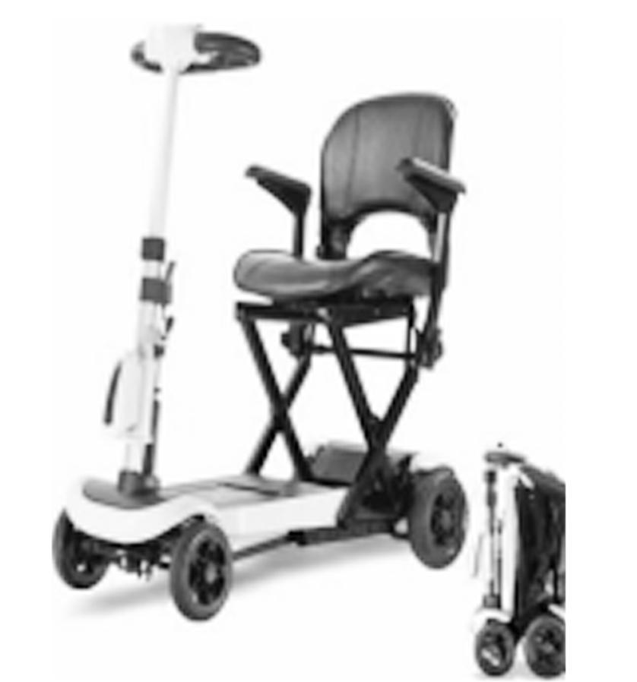
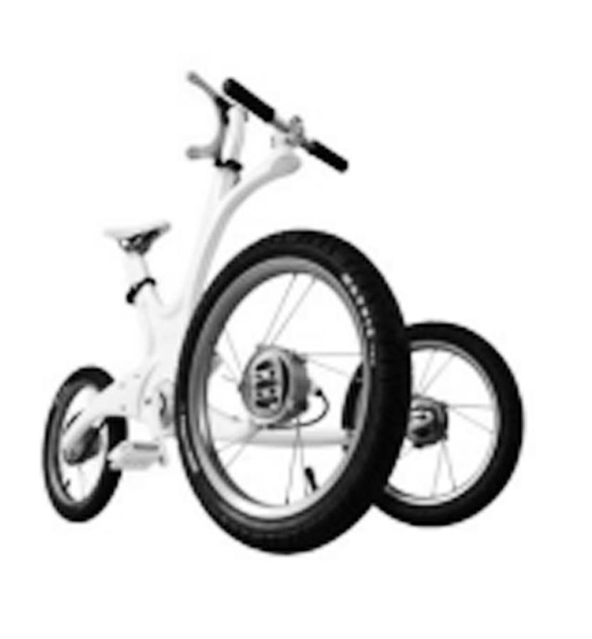
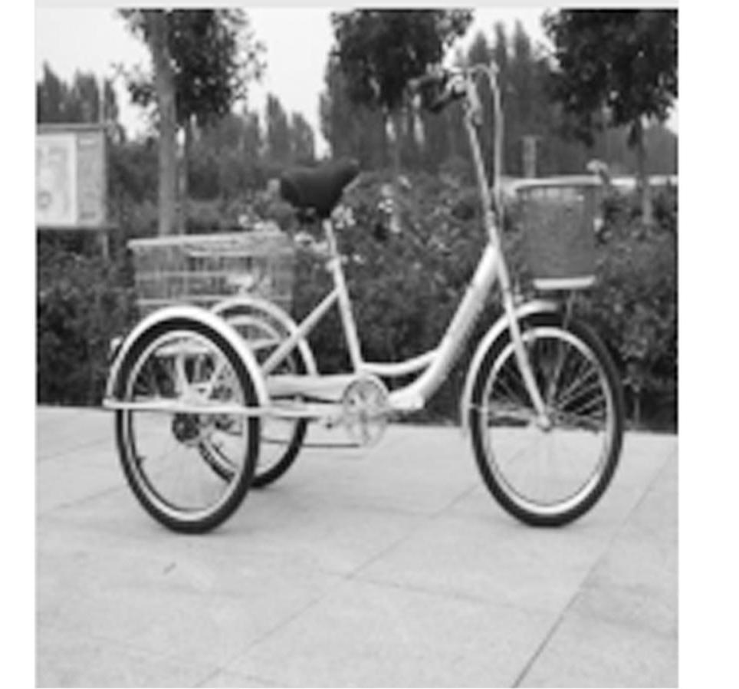
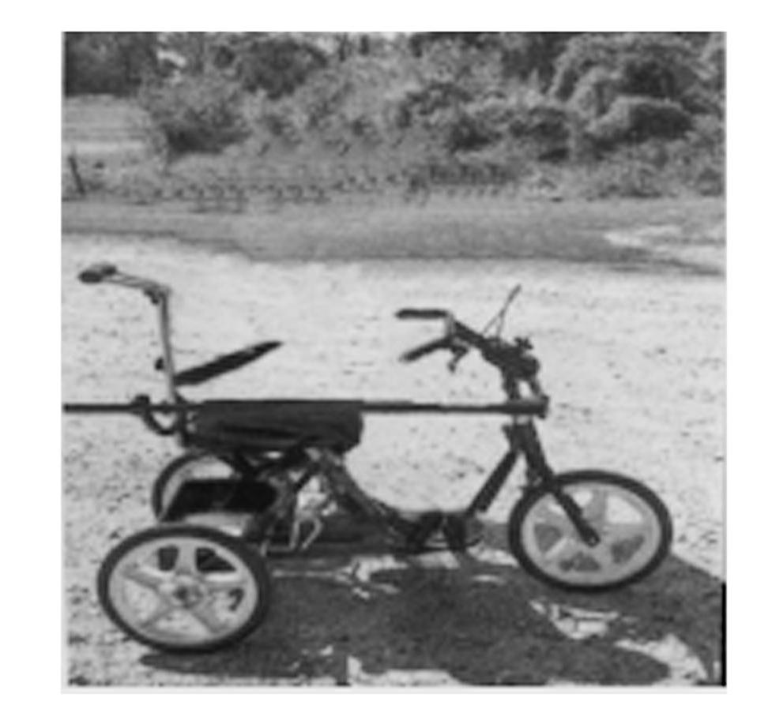
24.Which picture best illustrates the bike for Jack?( @7@ )
D
A. B. C. D.
【语篇导读】 本文是一篇记叙文。文章主要讲述了Andrew McLindon创办基金会为有特殊需求的孩子提供特殊单车，这些单车可以改变他们的人生。
细节理解题。根据第二段“a three-wheel bike with a balancing bar”可知，单车是三轮的，且带有一支平衡杠，图片D符合。故选D。

Slide 13
25.What’s the purpose of the McLindon Family Foundation?( @9@ )
A.To give away bikes. B.To help kids with mental problems.
C.To offer special bikes to particular kids.
D.To make profits from making special bikes.
C
[解析] 细节理解题。根据第三段“to find children who can benefit from owning an adaptive bike and to help make each bike to the particular needs of the child”可知，目的是找到那些需要特殊单车的特殊孩子，给他们提供单车。故选C。

Slide 14
26.Which words can best describe McLindon?( @11@ )
A.Kind and patient. B.Generous and cautious.
C.Rich and hard-working. D.Warm-hearted and helpful.
D
[解析] 推理判断题。根据文章McLindon所做的事可知，他是一个热心肠、乐于助人的人。故选D。

Slide 15
27.What can be the best title of the text?( @13@ )
A.McLindon and Life Bikes B.McLindon, an Aggressive Businessman
C.The McLindon Family Foundation D.Unusual Kids with Particular Needs
A
[解析] 主旨大意题。本文主要是讲McLindon创办的基金会为有特殊需求的孩子提供特殊的单车，这些单车可以改变他们的人生。故选A。

Slide 16
C
Queen Elizabeth II’s face is on every note and coin in the United Kingdom, but still little is known about how much money she has personally, how she gets it and who stands to inherit （继承） it.
What we do know from public records is that the Queen receives at least ＄20 million in annual income through her private estate, and another 100 million dollars from the UK government each year.
The first thing to understand is that the Queen’s income comes from both public and private possessions. A large amount of it comes from something called the Sovereign Grant. Here’s how that works.

Slide 17
In the 1700s, the monarchy （王室） handed over income from land to the government known as the Crown Estate. Each year the government pays a percentage of the profits made on those possessions back to the monarchy. That annual income is known as the Sovereign Grant. Last year it totaled more than ＄107 million. And it is used to fund the Queen’s official duties and maintain royal residences like Buckingham Palace.
But even if we can’t identify her exact worth, the royal finances are looking healthy as the Queen celebrates her 70th Queen Ceremony. The Sunday Times Rich List estimated the Queen’s net worth is ＄466 million, up ＄6.2 million dollars from last year. And while the Duchy of Lancaster saw UK income drop during the pandemic, according to its financial records, the Queen’s income has been turning upwards over the past decade.
Anyway, the monarchy is a private family, and they are unlikely to share any details of their wealth with the British public, and that probably won’t change anytime soon.

Slide 18
28.How does the Queen get her income?( @15@ )
A.From the Crown Estate.
B.From the Sovereign Grant.
C.From the monarchy and the government.
D.From the government and private possessions.
D
【语篇导读】 本文是一篇说明文。文章主要介绍了英国女王的收入构成及其用途。
细节理解题。根据第二段和第三段“the Queen’s income comes from both public and private possessions”可知，英国女王的收入有私人财产也有公家收入。故选D。

Slide 19
29.What’s the main idea of Paragraph 4?( @17@ )
A.How the Queen’s income is calculated.
B.How the monarchy cooperates with the government.
C.How the Sovereign Grant works and what the money is used for.
D.How the monarchy gets paid and what the Queen’s official duties are.
C
[解析] 推理判断题。第四段主要讲the Sovereign Grant 是如何运作的以及女王的钱用在哪里。故选C。

Slide 20
30.What can be inferred about the Queen’s income from Paragraph 5?( @19@ )
A.It can be exactly identified. B.It decreases during the pandemic.
C.It is more than that from last year. D.It is more than that of the UK government.
C
[解析] 推理判断题。根据“the Queen’s net worth is ＄466 million, up ＄6.2 million dollars from last year”可知，女王的收入较去年增加了。故选C。

Slide 21
31.Which section may the text be taken from?( @21@ )
A.Health. B.History. C.Education. D.Economy.
D
[解析] 推理判断题。本文介绍了英国女王的收入构成及其用途等，属于经济范畴。故选D。

Slide 22
D
Are you sleeping restlessly, forgetting little things, and feeling depressed and lonely? Don’t worry. We’ve all been there. You’re probably just stressed out.
Stress isn’t always a bad thing. It can be handy for a burst of extra energy and focus, like when you’re playing a competitive sport, or have to speak in public.
But when it’s continuous, the kind of situation most of us face daily, it actually begins to change your brain. Chronic （长期的） stress, like being overworked or having arguments at home frequently, can affect brain size, its structure, and how it functions, right down to the level of your genes.
As levels of cortisol （皮质醇） rise, electric signals in your hippocampus （海马体）, the part of the brain associated with learning, memories, and stress control, decline. When the hippocampus weakens, so does your ability to control your stress.

Slide 23
That’s not all, though. Cortisol can literally cause your brain to get smaller in size. Too much of it results in the shrinking of the part of your brain that regulates behaviors like concentration, decision-making, judgement, and social interaction.
It also leads to fewer new brain cells being made in the hippocampus. This means chronic stress might make it harder for you to learn and remember things, and also set the stage for more serious mental problems, like depression and eventually Alzheimer’s disease.
It’s not all bad news, though. There are many ways to change what cortisol does to your stressed brain. The most powerful weapons are exercise and getting into deep thoughts, which involves breathing deeply and being aware and focused on your surroundings. Both of these activities decrease your stress and increase the size of the hippocampus, and therefore your memory improves.
So don’t feel defeated by the pressures of daily life. Get control of your stress before it takes control of you.

Slide 24
32.On which occasion can stress be a good thing?( @23@ )
A.When making decisions. B.When delivering a speech.
C.When being in deep thought. D.When forgetting little things.
B
【语篇导读】 本文是一篇说明文。文章主要介绍了长期的压力的结果，会影响大脑的大小，结构，大脑的功能及基因的水平以及减小压力的方法。
细节理解题。根据第二段“It can be handy for a burst of extra energy and focus, like when you’re playing a competitive sport, or have to speak in public.”可知，在竞技性体育比赛和公开演讲之时的适量紧张是有利的。故选B。

Slide 25
33.What may influence your genes’ level according to the text?( @25@ )
A.Having chronic stress. B.Playing competitive sports.
C.Working overtime last Friday. D.Having a fight with your brother.
A
[解析] 细节理解题。根据第三段“Chronic stress … can affect brain size, its structure, and how it functions, right down to the level of your genes.”可知，影响基因水平的是chronic stress。故选A。

Slide 26
34.What does the underlined word “It” refer to in Paragraph 6?( @27@ )
A.Relevant behavior. B.Too much cortisol.
C.Social interaction. D.The smaller brain in size.
B
[解析] 推理判断题。代词“It”指代上文提到过的单数第三人称名词、短语或句子，根据第五段“Cortisol can literally cause …”可知，皮质醇会造成……；再根据“_It_ also leads to …”，两者属于并列递进关系，主语相同。故选B。

Slide 27
35.Which of the following can be a good way to relieve stress?( @29@ )
A.Sleeping a lot. B.Doing sports regularly.
C.Changing the cortisol. D.Having social interaction.
B
[解析] 细节理解题。根据“The most powerful weapons are exercise and …”可知，运动和冥想是两个好方法。故选B。

Slide 28
第二节 （共5小题；每小题2.5分，满分12.5分）
阅读下面短文，从短文后的选项中选出可以填入空白处的最佳选项。选项中有两项为多余选项。
lf you travel to nearly any Chinese city in the summertime, you will see people, mostly men wearing T-shirts, sitting out on the sidewalks on low chairs in the shade, playing a game with large round disks of wood. 36.____. Xiangqi dates back as early as the Warring States period. While experts have different opinions as to who created Xiangqi and how it is linked to Western chess, there is no doubt that by the Tang Dynasty Xiangqi was a popular game in China. 37.____. And in the 20th century both Sun Yat-sen and Zhou Enlai were big fans of the game.
D
B

Slide 29
And, though it may look quite a bit different than Western chess, Xiangqi is actually quite similar in what the pieces can do and how the game is played. Like Western chess, the object of the game is to capture the other player’s “king”. 38.____.
Unlike Western chess, instead of placing the pieces in squares, the pieces are placed on the intersections of lines. Another big difference between Western chess and Xiangqi is that there is a large empty space in the middle of the board, which the elephants cannot cross. 39.____. This space refers to an area in China where Liu Bang and Xiang Yu had a life-or-death war. The war was so influential that “the Chu River and the Han Boundary” has become a metaphor （隐喻） referring to any boundary between two opposing armies. When the Chinese people today see this name on the board, the battle scenes come to their mind, as though they are surrounded by thick smoke, able to hear the beating of war drums. 40.____.
A
C
F

Slide 30
A. Actually, in Xiangqi he is just a general.
B. During the Qing Dynasty its popularity grew.
C. It is called “the Chu River and the Han Boundary”.
D. The game is called Xiangqi, a game of ordinary people.
E. There are many differences between Xiangqi and Western chess.
F. An intense battle is about to take place on this small chessboard.
G. Several sayings related to Xiangqi are in common use in China today.

Slide 31
D
36.____
【语篇导读】 本文是一篇说明文。文章主要介绍了中国的象棋。
上文描述了play a game的景象，下文介绍象棋可以追溯到战国时代，36空应该指出the game 是象棋，选项D符合逻辑关系。故选D。
B
37.____
[解析] 上文介绍象棋在中国历史悠久，很受欢迎，按时间顺序：战国时期—唐朝—清朝—民国，选项B符合时间、逻辑关系。故选B。

Slide 32
A
38.____
[解析] 根据上文，跟西方象棋一样，中国象棋的目的也是擒“王”，A选项符合题意。故选A。
C
39.____
[解析] 根据上文中国象棋中有个空间是象不能越过的，下文提到这个空间就是刘邦和项羽打生死战的地方，选项C对这个空间进行定义，符合逻辑。故选C。
F
40.____
[解析] 根据上文提到楚河汉界是一种隐喻，下象棋时棋盘也是个战场，人们看到这个名字就好像沉浸在硝烟四起、战鼓喧天的战争场面，选项F符合逻辑。故选F。

Slide 33
第三部分 语言运用（共两节，满分30分）
第一节 （共15小题；每小题1分，满分15分）
阅读下面短文，从每题所给的 A、B、C、D 四个选项中选出可以填入空白处的最佳选项。
Born in 1993 in Caijiagang town in Changde, Hunan Province, Ma Xiaojuan attended the Hunan First Normal University, graduating from the College of Music and Dance in 2015.

Slide 34
As a teacher at a rural school, she teaches a range of different . .41. ., including music and English, and is also a head teacher. She knows school nights at rural . .42. . schools can sometimes be lonely. “It . .43. . me of my own childhood. My parents . .44. . in big cities, so I know the students feel . .45. . sometimes. I want to spend time with them and . .46. . them company,” Ma said. That was how she started telling her students . .47. . stories.
One day, Ma noticed that some of her students were . .48. . their red school scarves the wrong way. That evening, she told them a story . .49. . The Color of the Red Scarf, so that they would . .50. . understand why they all wore them. Occasionally, Ma tells stories about famous . .51. . figures, including Mao Zedong, Deng Xiaoping and Zhou Enlai. To tell better stories, Ma spends her free time searching book stores for . .52. ., and now she has written 168 stories.
Thanks to their teacher’s . .53. ., Ma’s students don’t just enjoy listening, they also enjoy . .54. . stories themselves. Her devotion to teaching and to her students is . .55. . other teachers in Hunan.

Slide 35
41.( @46@ )A.languages B.subjects C.kids D.majors
B
【语篇导读】 本文是一篇记叙文。文章主要讲述了湖南省常德市90后乡村教师麻小娟的故事。每天晚上就寝前麻老师都要给学生讲故事，为寄宿的留守儿童带来了温暖，她的事迹也激励了其他老师。
根据常识，麻小娟是老师，教的应该是科目，下文“music and English”就是具体的科目。故选B。
42.( @48@ )A.interesting B.challenging C.satisfying D.boarding
D
[解析] 根据下文“lonely”以及“I want to spend time with them and 46 them company”可知，学生感到孤独，“我”想花时间跟学生做伴，可推断出这是一所寄宿学校。故选D。

Slide 36
43.( @50@ )A.warned B.informed C.reminded D.accused
C
[解析] 根据“of my own childhood”可知，remind sb. of sth.使某人想起什么事情，表示对童年的回忆。故选C。
44.( @52@ )A.worked away B.passed down C.turned back D.gave up
A
[解析] 上文讲到麻老师对童年的回忆，父母在大城市工作，自己感到孤独，所以她才能体会到寄宿学生的孤独。故选A。

Slide 37
45.( @54@ )A.friendly B.lonely C.lively D.lovely
B
[解析] 根据“school nights at rural 42 schools can sometimes be lonely”可知，“lonely”为原词复现。故选B。
46.( @56@ )A.prove B.provide C.keep D.knock
C
[解析] 根据“spend time with them”可知，麻老师想花时间跟他们在一起，跟他们做伴。故选C。

Slide 38
47.( @58@ )A.love B.bedtime C.adventure D.detective
B
[解析] 根据上文“school nights”可知，麻老师给学生讲的是睡前故事。故选B。
48.( @60@ )A.washing B.painting C.folding D.wearing
D
[解析] 根据下文“why they all wore them”可知答案。故选D。
49.( @62@ )A.introduced B.explaining C.called D.suggesting
C
[解析] The Color of the Red Scarf是故事的名字，故选called。故选C。

Slide 39
50.( @64@ )A.better B.worse C.less D.farther
A
[解析] 上文提到，麻老师看到学生佩戴红领巾的方式不对，因此给学生讲《红领巾的颜色》的故事，是为了让学生更好地理解他们为什么要佩戴红领巾。故选A。
51.( @66@ )A.musical B.magical C.electrical D.historical
D
[解析] 根据下文所列人物“Mao Zedong, Deng Xiaoping and Zhou Enlai”可知，他们都是历史人物。故选D。
52.( @68@ )A.inspiration B.evidence C.experience D.permission
A
[解析] 根据上文“To tell better stories”以及下文“she has written 168 stories”可知，麻老师去书店是为了找讲故事和写故事的灵感。故选A。

Slide 40
53.( @70@ )A.advice B.introduction C.influence D.conclusion
C
[解析] 根据下文可知，麻老师的学生不仅喜欢听故事，而且喜欢自己讲故事，由此可知这是麻老师给学生带来的潜移默化的影响。故选C。
54.( @72@ )A.copying B.typing C.recalling D.telling
D
[解析] 根据上文“Thanks to their teacher’s 53 ”可知，在麻老师的影响下，学生不但喜欢听故事，他们也跟老师一样，喜欢讲故事。故选D。
55.( @74@ )A.threatening B.encouraging C.ignoring D.comforting
B
[解析] 最后一段讲麻老师对学生和老师的影响，她对教学和学生所做的奉献也激励着湖南的其他老师。故选B。

Slide 41
第二节 （共10小题；每小题1.5分，满分15分）
阅读下面短文，在空白处填入1个适当的单词或括号内单词的正确形式。
Food and Eating Habits
Throughout China’s history, eating habits have been influenced by many factors such as geography, religion, society and economy. As 56.____. result, food and eating habits are not only indicative of the social status, but characteristic of one group, differing in regions, 57._________. （family）, peoples or religions to some extent.
The Chinese diet 58.____________. （emphasize） rice and grains, followed by fruits, vegetables, nuts and seeds. Food 59._______. （make） of wheat flour is the staple （主食） for people living in the north, while rice is the main staple in the south.
a
families
emphasizes
made

Slide 42
consuming
Chinese people also have a habit of 60.____________. （consume） green tea, and plant-based alcoholic beverages （饮料） such as rice wine, beer and grain liquor moderately. The typical Chinese alcoholic beverage is baijiu, 61.________. is made from various grains. 62._____________. （additional）, Chinese people like to drink hot water or tea with their meals since hot water is helpful for 63.__________. （digest） according to traditional Chinese medicine.
Nowadays, Chinese people like to eat out with relatives and friends during weekends or festivals. A typical meal starts 64._______. some cold dishes, like boiled peanuts and smashed cucumber with garlic, followed by the main courses, including hot meat and vegetable dishes. Finally, soup 65.____________. （bring） onto the table, followed by the staple food, rice, noodles, or sometimes dumplings.
which
Additionally
digestion
with
is brought

Slide 43
a
56.____
【语篇导读】 本文是一篇说明文。文章主要介绍了中国的饮食习惯。
as a result是固定短语。故填a。
families
57._________
[解析] 根据空格前面的“regions”以及空格后面的“peoples or religions”可知，空格与前面的名词和后面的名词是并列关系，都是复数形式。故填families。
emphasizes
58.____________
[解析] 句子主语是The Chinese diet，第三人称单数，本段谓语用的是一般现在时。故填emphasizes。

Slide 44
made
59._______
[解析] 本句已有谓语动词is，空格处与is没有连词连接，所以空格处应该填非谓语动词，food和make之间是被动关系。故填made。
consuming
60.____________
[解析] 所给的词位于介词of之后，动词应用-ing形式。故填consuming。
which
61.________
[解析] 此处是一个非限制性定语从句，从句缺主语，先行词指物。故填which。
Additionally
62._____________
[解析] 此处作句子状语，应用副词。故填Additionally。

Slide 45
digestion
63.__________
[解析] 空格处作宾语，需用名词。故填digestion。
with
64._______
[解析] start with 以……开始。故填with。
is brought
65.____________
[解析] 句子缺谓语动词，food与bring之间是被动关系，主语是单数名词。故填is brought。

Slide 46
第四部分 写作（共两节，满分40分）
第一节 （满分15分）
假定你是李华，是校英文报的编辑，打算对你校外教David做一次关于如何提升学生英语听说能力的访谈。内容包括：
1.校英文报介绍；
2.访谈的时间和内容。
注意：
1.写作词数应为80左右；

Slide 47
2.请按如下格式在答题卡的相应位置作答。
Dear David, Yours sincerely, Li Hua

Slide 48
[答案] One possible version:
Dear David,
I’m Li Hua, chief editor of the school English newspaper. I’d like to invite you to join in our talks at 8 p.m. next Sunday.
Our school English newspaper enjoys great popularity among students in our school, which provides a platform for us to have a deeper insight into English learning, English culture and customs. We’d like you to talk about your teaching experience and share with us your opinions on how to improve our ability of English listening and speaking.
I am looking forward to your early reply.
Yours sincerely,
Li Hua

Slide 49
第二节 （满分25分）
阅读下面材料，根据其内容和所给段落开头语续写两段，使之构成一篇完整的短文。
I recently had a challenging time working on a group project. My teacher put me with three people who weren’t all that excited about getting any work done, and the experience was extremely stressful.
Our assignment was to pick one of the 50 states and make a brochure about it.
“Let’s pick Hawaii!” said Cupcake. “Hawaii has super cute swimsuits.”
“That is so true!” said Cookie. “Speaking of swimsuits, there are some get-ready-for-summer sales happening right now.”
“Really? Maybe my mom will take me shopping this weekend,” said Cupcake.
I turned to Volcano. “Which state do you think we should pick?”

Slide 50
Volcano shrugged （耸肩）. “I don’t care. But what happened to your hair, Arizona? It looks like it got caught in a blender （搅拌机）!” The rest of Volcano’s comments during the meeting were equally “helpful.”
At our next group meeting, no one seemed very eager to talk about our brochure, so I went ahead and shared the interesting facts I’d learned about Hawaiian food and culture. When I was done, no one said anything, so I pulled out my notebook. “Cupcake, you had offered to search for pictures of Hawaiian sea life. Were you able to find some?”

Slide 51
“I didn’t have time,” she answered, “but here’s a photo of me at the hotel pool in Hawaii.” I looked at the picture she had taped in her notebook and smiled. “You look great, but you probably don’t count as sea life. Cookie, you were going to find some historical information. And Volcano, you were in charge of Hawaiian geography, right?”
“I’ll do my part soon,” said Cookie. “I’ve been really busy lately.”
“Me, too. I’ve been really busy!” said Volcano.
I was getting the impression that no one but me planned to work on the brochure. “What am I going to do? Do I have to do all the work for everyone if I don’t want a bad grade?”
注意：
1.续写词数应为150左右；

Slide 52
2.请按如下格式在答题卡的相应位置作答。
As we set the table for dinner, my mom could tell I was stressed out. And at our next group meeting, I tried to bring up my concerns in a friendly way.

Slide 53
[答案] One possible version:
As we set the table for dinner, my mom could tell I was stressed out. “What’s going on?” she asked. “No one else in my group is doing any work,” I told her. “So I thought that the only way to get the brochure done is to do it myself.” “Well,” my mom said with a smile. “First of all, I think you should talk with your group about your concerns in a friendly way. Secondly, you should do the best job you can on your part of the assignment.” After hearing my mother’s words, I was lost in thought.
And at our next group meeting, I tried to bring up my concerns in a friendly way. “Since we’re working as a team, we’re all relying on each other to do the best we can,” I told them. “If anyone is having trouble, maybe we can talk about solutions together.” Surprisingly, Cupcake, Cookie, and Volcano all ended up doing their share. They didn’t necessarily do things the way I would have, but I guess that’s the deal with group projects.

